Slide 1
Introduction to Transformers
EE 240, Spring 2024
IIT Bombay
Shiladri Chakraborty, Sandeep Anand, Anil Kulkarni, S. Soman
Assistant Professor, EE, IIT Bombay

Slide 2
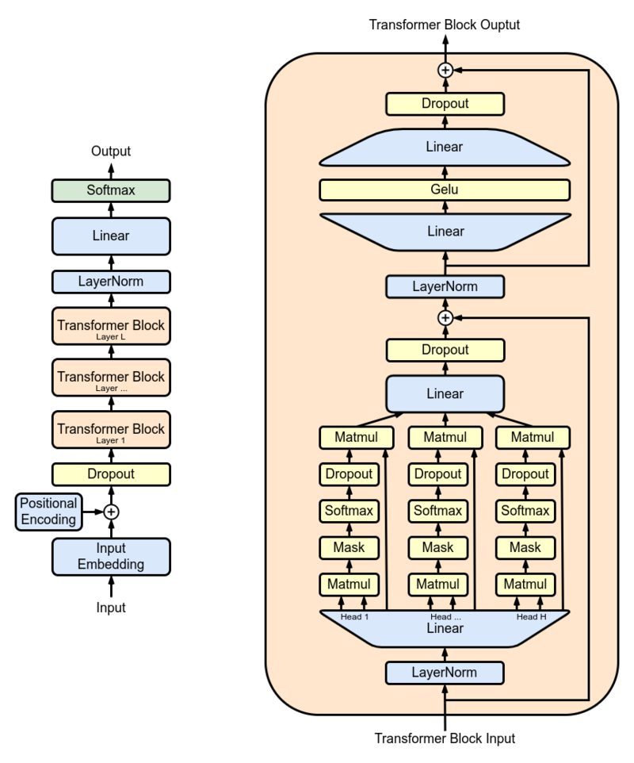
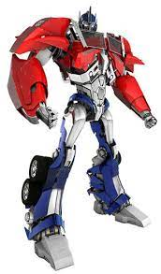
Agenda
x
x
Electromagnetic transformers ✓
EE 240, Spring 2024 – Introduction to Transformers

Slide 3
Agenda
What was the motivation behind the origin of transformer technology?
What are the different types of “power” transformers used in power system?
What are some other types of transformers?
What are high-frequency transformers? Why are they used in power electronics?
What are instrument transformers?
What is an impedance matching transformer?
What is an isolation transformer?
What are air-core transformers?
What are some future advances in transformer technology
What are “planar” transformers?
What is a “solid-state” transformers?
EE 240, Spring 2024 – Introduction to Transformers

Slide 4
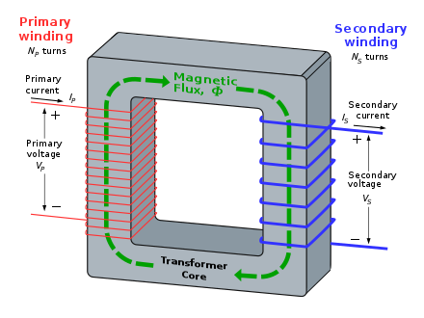
Transformer operation – recap
V_{p}/V_{s} = N_{p}/N_{s} (Faraday’s law)
I_{p}N_{p} = N_{s}I_{s} (Ampere’s law)
“Ideal” transformer eqns. -Not exactly true for practical transformers – why? (relates to today’s experiment)
Image Source: Wikipedia
EE 240, Spring 2024 – Introduction to Transformers

Slide 5
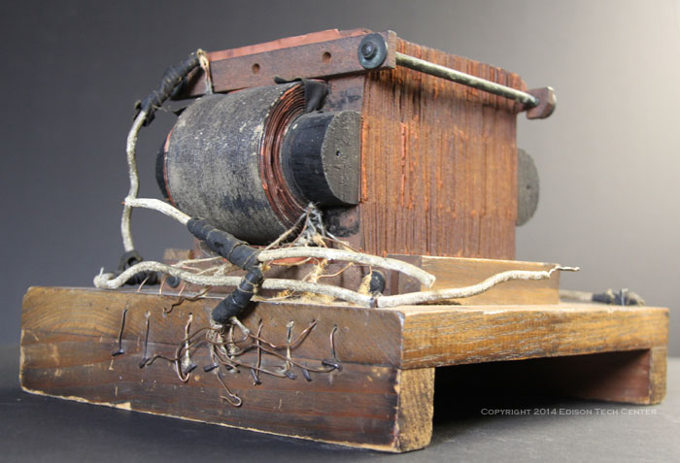
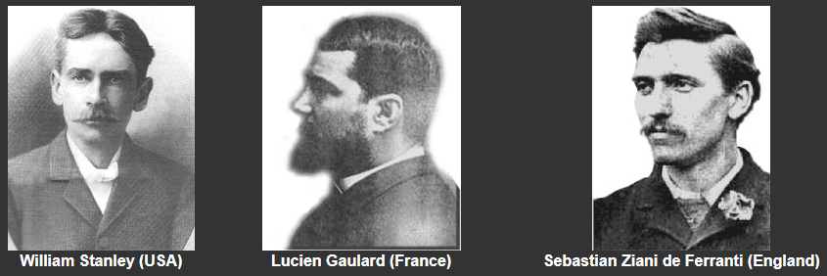
History of transformers
Source of images: edisontechcenter.org
One of the earliest commercial transformer (developed by William Stanley in 1885) on display at the Berkshire Museum.
EE 240, Spring 2024 – Introduction to Transformers

Slide 6
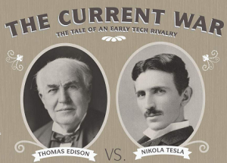

History of transformers
Why the transformer gained popularity in the late 1800s?
In 1880s, the default power transmission was DC
DC transmission was not very economical – why?
Low voltage transmission -> higher currents -> more Ohmic losses
DC voltage could not increased for transmission
EE 240, Spring 2024 – Introduction to Transformers

Slide 7
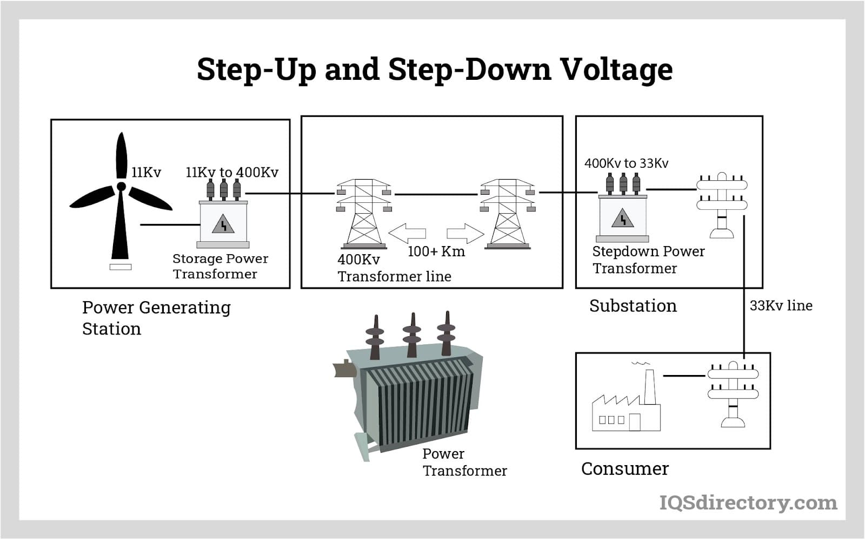
History of transformers
Why the transformer gained popularity in the late 1800s?
Transformers allowed voltage step-up at the power generating station and voltage step-down at the load end -> a major reason propelling adoption of ac power transmission
Tesla’s invention of the ac induction motor (instead of existing dc motors) helped tip the scale further in favour of ac power transmission
Image Source: iqsdirectory.com
EE 240, Spring 2024 – Introduction to Transformers

Slide 8
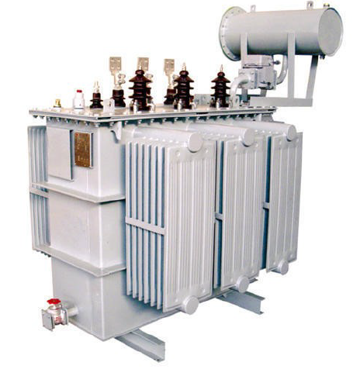
High-power Transformers
Transformers used in power sub-stations
EE 240, Spring 2024 – Introduction to Transformers

Slide 9
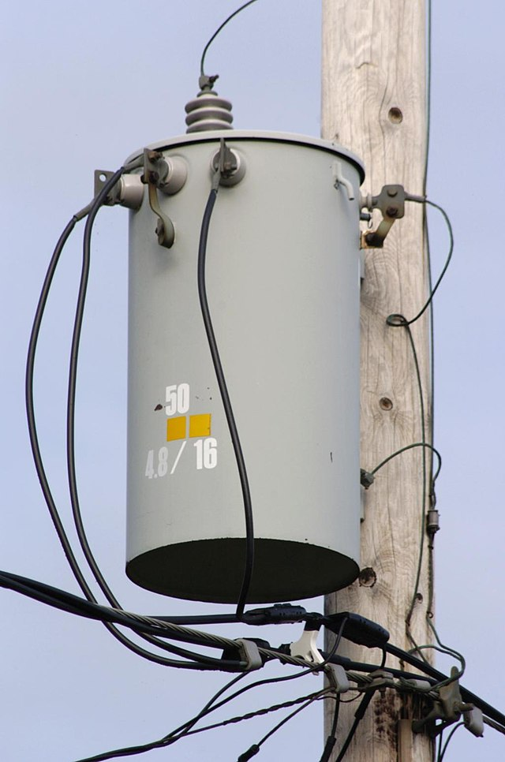
High-power Transformers
“Pole”- mounted distribution transformer
Image Source: Wikipedia
EE 240, Spring 2024 – Introduction to Transformers

Slide 10
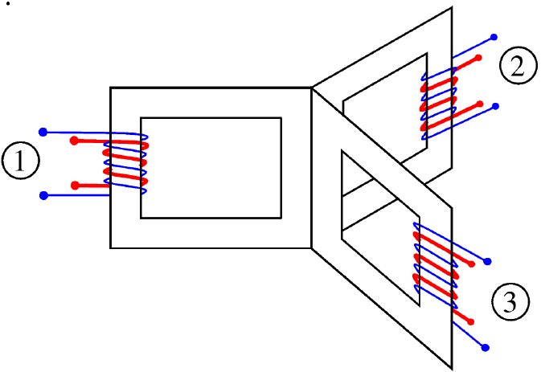
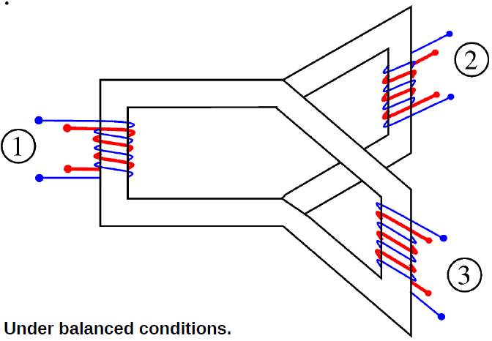
Three-phase Transformer
Why?
EE 240, Spring 2024 – Introduction to Transformers

Slide 11
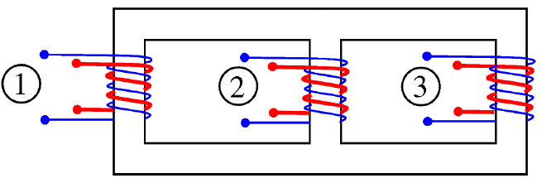
Three-phase Transformer
EE 240, Spring 2024 – Introduction to Transformers

Slide 12
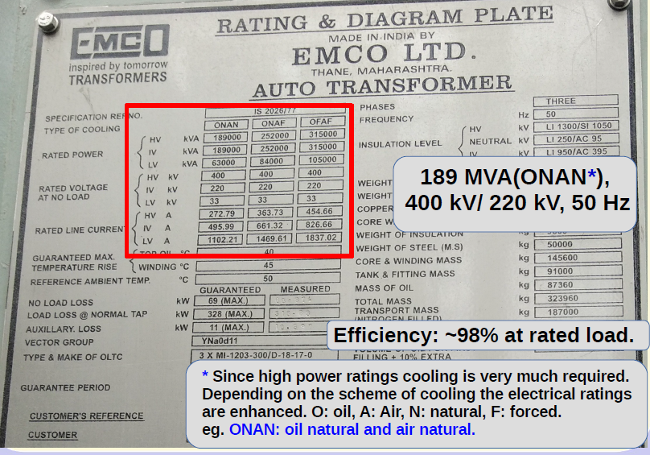
High-power Transformer – Name plate
EE 240, Spring 2024 – Introduction to Transformers

Slide 13
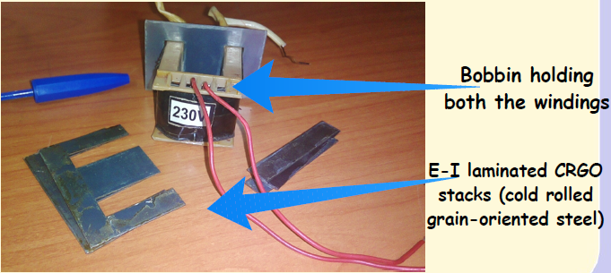
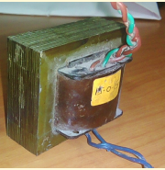
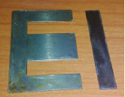
Transformer – Basic construction
Core “laminations” – why?
EE 240, Spring 2024 – Introduction to Transformers

Slide 14
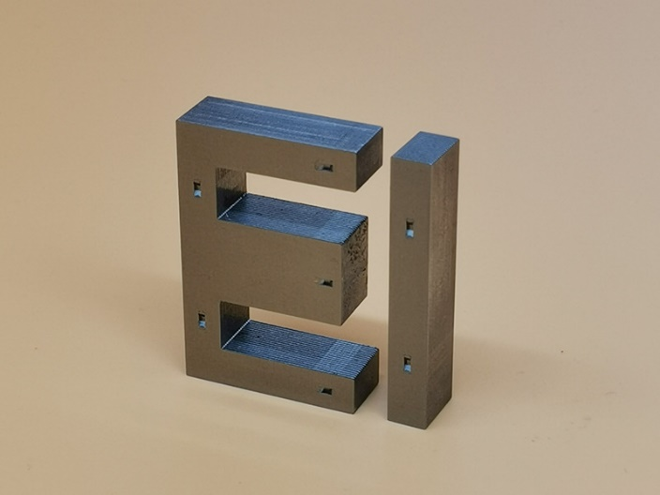
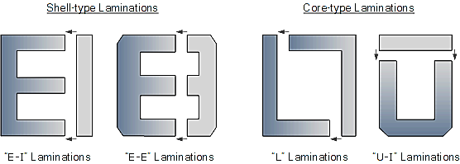
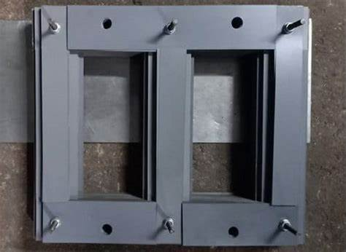
Transformer – Basic construction
Image courtesy : www.siliconsteelstrip.com
EE 240, Spring 2024 – Introduction to Transformers

Slide 15
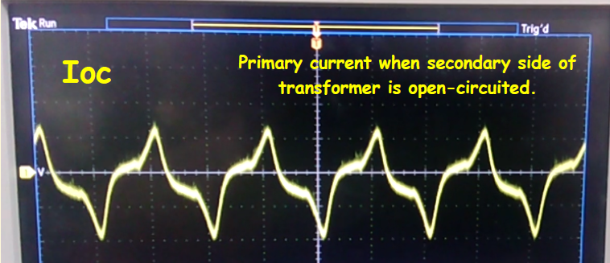
Transformer no-load current
Secondary open -> “no-load”
“Peaky” no-load current – why?
EE 240, Spring 2024 – Introduction to Transformers

Slide 16
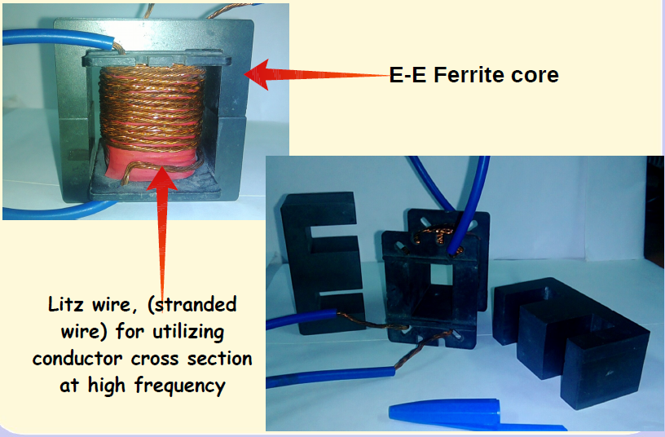
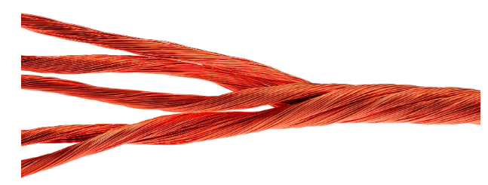
High-frequency transformer
Why operate at high frequency? (high-freq. = few kHz to 100s of kHz)
Litz wire (hf winding)
Image courtesy : Rubadue Wire
- Helps reduce “skin effect” and keep winding resistance low
EE 240, Spring 2024 – Introduction to Transformers

Slide 17
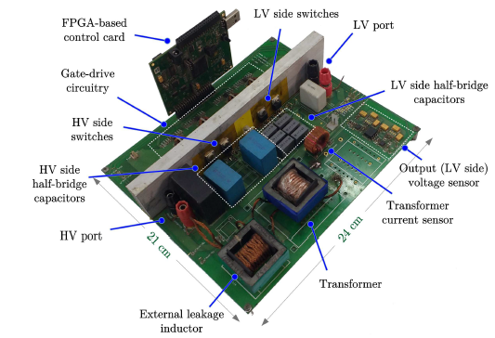
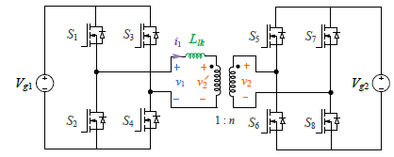
High-frequency transformer
Widely used in many high-frequency power electronic circuits
Particularly useful when input and output voltages are wide apart (e.g. 48 V to 400 V)
EE 240, Spring 2024 – Introduction to Transformers

Slide 18
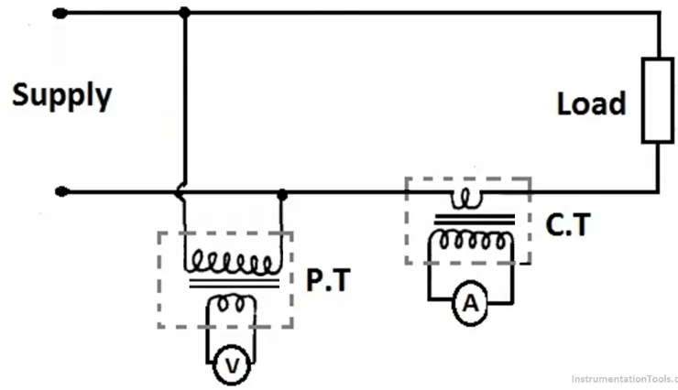
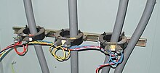
Low-power transformers – e.g. Instrument transformers
For sensing (ac) voltages and currents
CTs used for 3-ph. 400 A supply
Image Source: www. instrumentationtools.com
Image Source: Wikipedia
EE 240, Spring 2024 – Introduction to Transformers

Slide 19
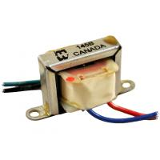
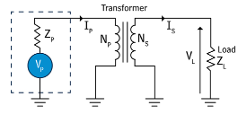
Low-power transformers – e.g. Impedance matching
What is “impedance matching”?
Why do impedance matching?
- Maximum power transfer to load
Image Source: Hammond 14x series audio transformer datasheet.
e.g., used in audio amplifiers to match amplifier output resistance with (reflected) resistance of load (speaker)
Image Source: www.powersystemsdesign.com
EE 240, Spring 2024 – Introduction to Transformers

Slide 20
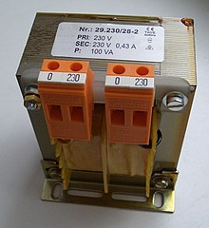
Other types of transformers – Isolation transformers
Image Source: Wikipedia
1:1 (no step-up or step-down)
- Why use it?
EE 240, Spring 2024 – Introduction to Transformers

Slide 21
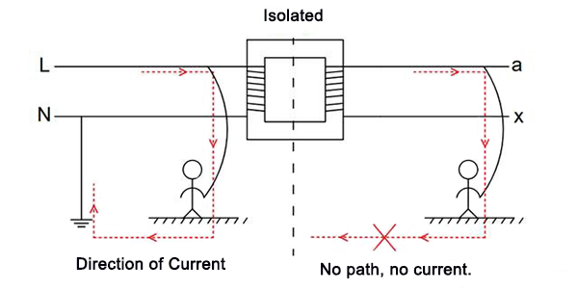
Other types of transformers – Isolation transformers
Image Source: peacosupport.com
Image Source: Wikipedia
For prevention of electrical shocks
1:1 (no step-up or step-down)
- Why use it?
EE 240, Spring 2024 – Introduction to Transformers

Slide 22
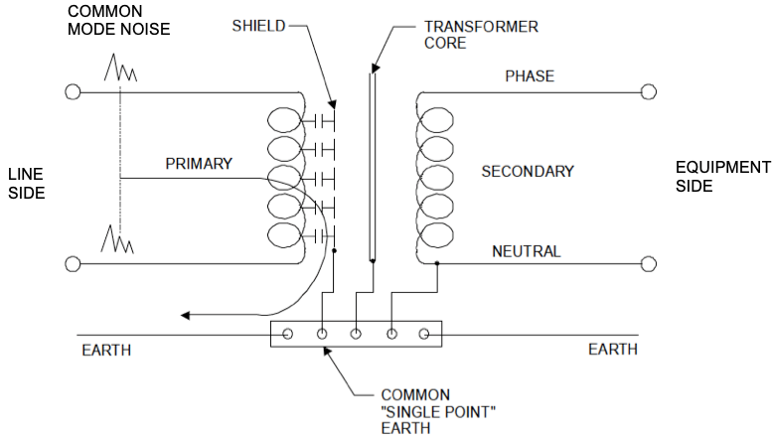
Other types of transformers – Isolation transformers
For protection of equipment from “common-mode” noise/surge voltages
Image Source: “Isolation Transformers and Surge Protection,” Technical note TNCR0016.
EE 240, Spring 2024 – Introduction to Transformers

Slide 23
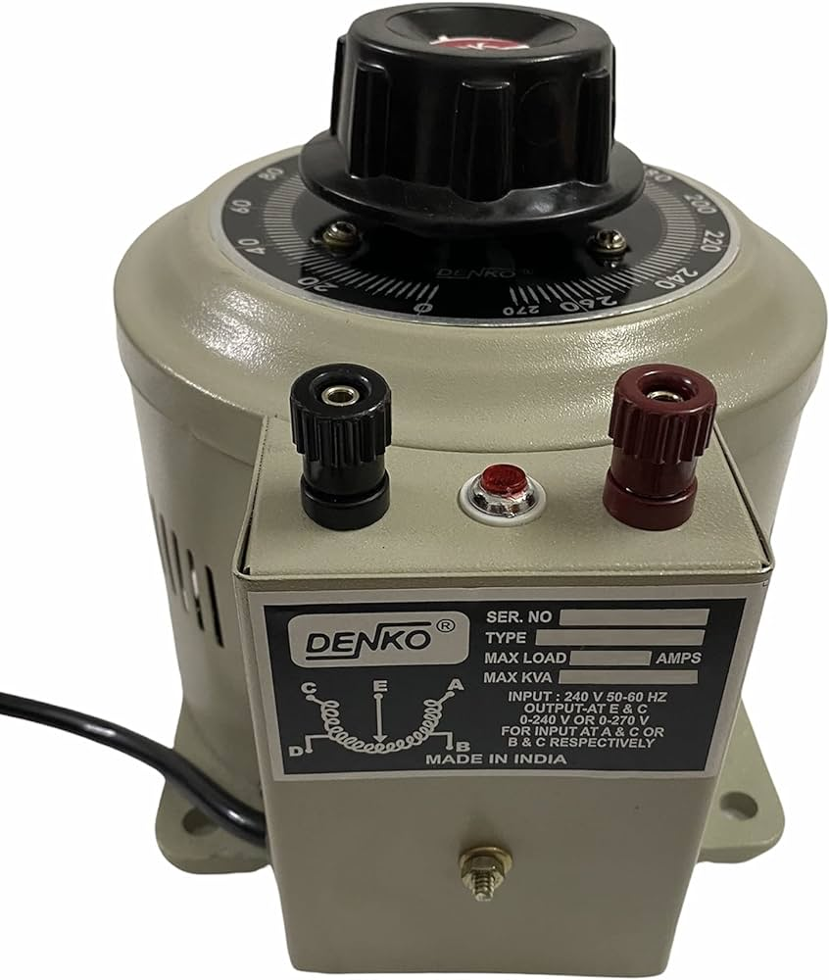
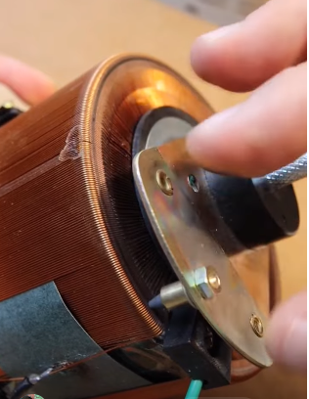
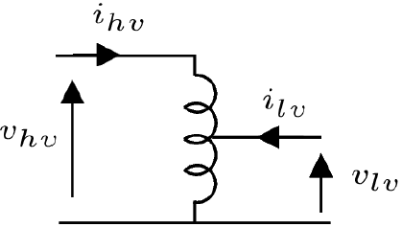
Other types of transformers – “Auto”transformer (Variac)
No isolation between input and output ports (only one winding)
Allows continuous variation of voltage from a fixed ac voltage supply
Power transferred both inductively (as in a classical transformer) and conductively
Image Source: “Variac Supply Teardown”, Youtube
Image Source: Denko
EE 240, Spring 2024 – Introduction to Transformers

Slide 24
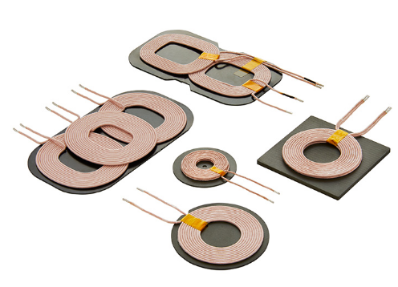
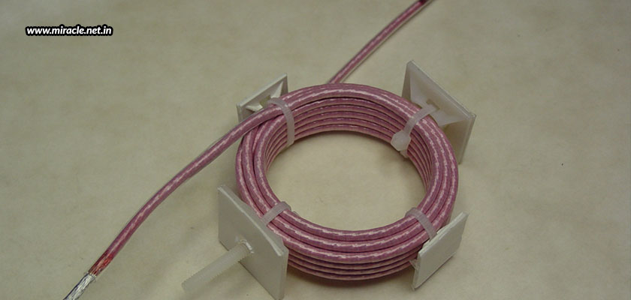
Other types of transformer - Air-core transformer
Generally operate at even higher frequency (exceeding MHz->RF range)
Image Source: www.miracle.net
Wireless power transfer coils
EE 240, Spring 2024 – Introduction to Transformers

Slide 25
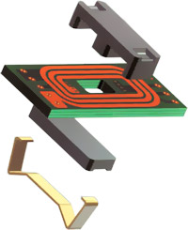
Future advances in transformer technology
“Planar” transformers
Image Source: terratel.eu
EE 240, Spring 2024 – Introduction to Transformers

Slide 26
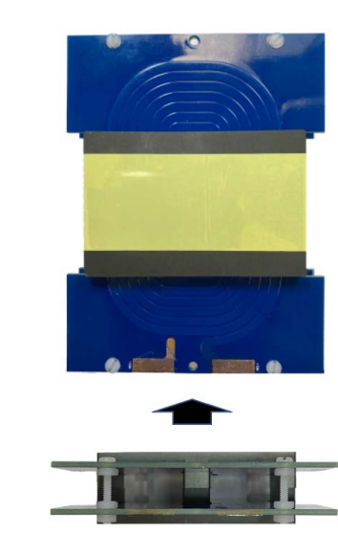
Future advances in transformer technology
Low profile
Better thermal performance
Repeatable value of parasitic resistance, inductance, capacitance
Automated manufacturing
“Planar” transformers
Image Source: terratel.eu
Image Source: Park et. al, TTE 2021.
EE 240, Spring 2024 – Introduction to Transformers

Slide 27
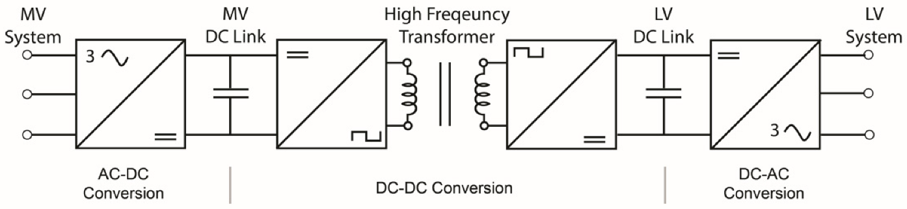
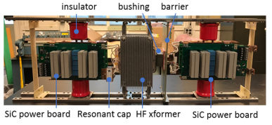
Future advances in transformer technology
“Electronic”/ “Solid-state” transformers
Smaller than 50 Hz transformer
Allow frequency, reactive power, voltage amplitude control
Allows integration of renewable energy sources and energy storage elements (battery)
Image Source: Dong Dong et. al, “A Modular SiC High-frequency Solid-state Transformer”
EE 240, Spring 2024 – Introduction to Transformers

Slide 28
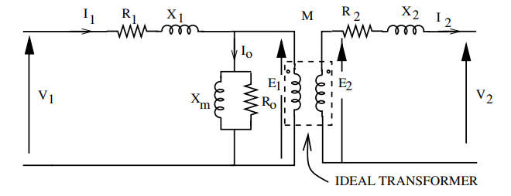
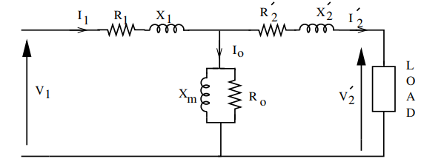
Today’s experiment – Equivalent Circuit Parameters
Open Circuit Test
How to get the equivalent circuit parameters?
Short Circuit Test
EE 240, Spring 2024 – Introduction to Transformers

Slide 29
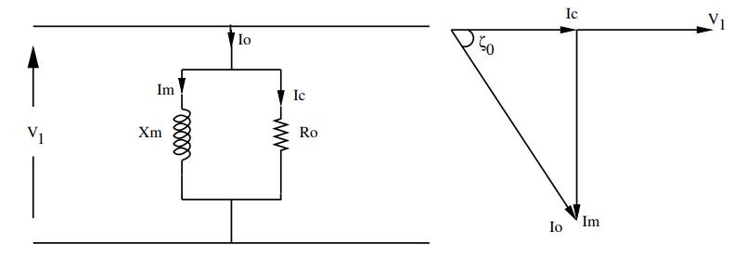
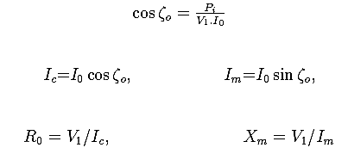
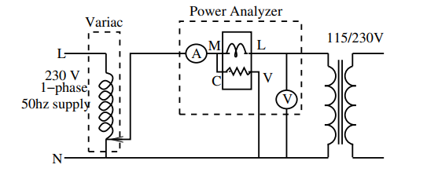
Parallel parameters (OC Test)
Performed at rated voltage.
Generally HV winding is kept open & rated voltage is applied at the LV winding (why?)
Equivalent circuit & phasor diagram at no-load
Circuit diagram for no-load test
EE 240, Spring 2024 – Introduction to Transformers

Slide 30
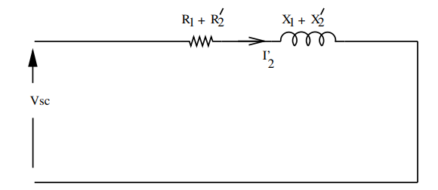
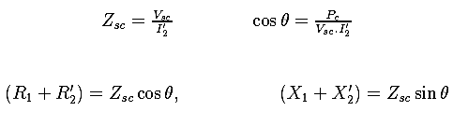
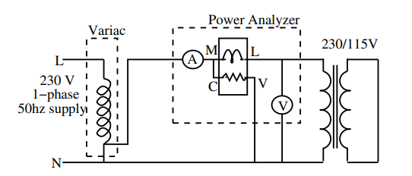
Series Parameters (SC Test)
LV terminals are shorted (why?)
HV side voltage is gradually applied till the rated current flows in the winding.
Equivalent circuit diagram on short circuit
Circuit diagram for full load test
EE 240, Spring 2024 – Introduction to Transformers

Slide 31
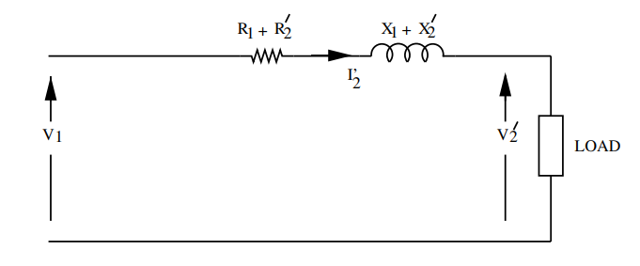
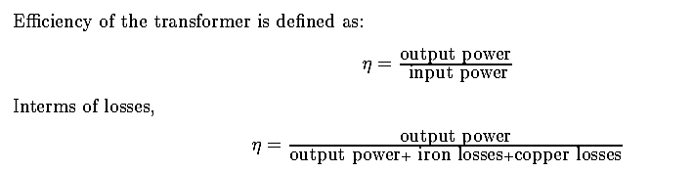

Efficiency & Voltage Regulation
Equivalent circuit diagram to determine regulation
EE 240, Spring 2024 – Introduction to Transformers

Slide 32
References
[1] “The History of the Transformer,” https://edisontechcenter.org/Transformers.html.
[2] “The (Shocking) History & Physics of Electric Transformers,” https://kathylovesphysics.com/the-shocking-history-physics-of-electric-transformers/.
[3] "The War of the Currents: AC vs. DC Power," https://www.energy.gov/articles/war-currents-ac-vs-dc-power#:~:text=During%20the%20early%20years%20of,the%20solution%20to%20this%20problem.
[4] “Isolation Transformers and Surge Protection,” Technical note TNCR0016.
[5] “Isolation Transformers can save your life, and your equipment.” Youtube. https://www.youtube.com/watch?v=3rvEdHyAd2k
[6] “Variac supply Teardown – How it Works?” Youtube. https://www.youtube.com/shorts/QJPEScMgbpc
EE 240, Spring 2024 – Introduction to Transformers

